Slide 1
OBI technical issues
Jie Zheng

Slide 2
Outline
OBI release
MIREOT
Deprecated terms
Other …

Slide 3
OBI release
Current status
Over 10 steps
Using Java, Perl, Lisp, SPARQL
Different software: Protégé, Twinkle, Text Editor
Optimal:
One click and everything or most steps are DONE

Slide 4
OBI release

Slide 5
OBI release pipeline (1)
Assign OBI IDs (Java)
All new terms will be listed in an Excel file can be used to create new classes HTML file
Quality checking (SPARQL, using Twinkle)
  No duplicate rdfs:label, definition
  Label and editor preferred label should be same
  Curation status, should no terms in the release version with ‘uncurated’ curation status
anything else?
(Nice to incorporate with release tool, can be implemented by Jena)

Slide 6
OBI release pipeline (2)
Add editor preferred labels if they are missing (Required/recommended by OBO policy, Java)
(Carlo argue why we need ‘editor preferred label’)
(Nice to incorporate with release tool if needed)
Generate disjoint axioms (Lisp script)
Issue:
disjoint axioms are pretty large, sometime we have problem to make inferred version of OBI because run out of memory
Nice to have for consistency checking
Do we need to add disjoints in the release version?
(Nice to have Java code for this step)

Slide 7
OBI release pipeline (3)
Generated merged inferred OBI files (Java)
  (Oort tool can be used for this step, better to save inferred axioms in OWL format, still need do some testing)
  http://code.google.com/p/owltools/wiki/Oort
  Question:
  Do we want to merge all imported ontologies in the release version?
  Do we need to track which version of IAO, BFO, etc. merged? And how?
  Current merge IAO, how about bfo.owl? Do we need protege-dc.owl? (for Protégé 3.v)
  (Previously we imported IAO, BFO in the release version)
Clean up (using Protégé)
  Delete defined class place holder: (_defined_material, _defined_process)
  Remove all ‘curation note’ annotation property
  (Nice to incorporate with release tool)
  Question:
  Do we need to keep _defined_material, _defined_process, _defined_material in OBI?
Notes:
Melanie: delete placeholders: in the original java code that I wrote to merge the files those were deleted programatically (though the IDs were hard coded in the file) I don't think any of both solutions (hard coded or deleted by hand) is sustainable however, so if we could do without those, I would just remove them from OBI. People who want to keep them could help with the release

Slide 8
OBI release pipeline (4)
Counts of classes and properties (for release notes, Lisp)
  (Nice to have Java version and incorporate with release tool)
Create IEDB view, extract IEDB specified annotation properties in a separate file (Java)
  (Nice to incorporate with release tool)
OBI metadata modification
  Add version information, (contains SVN revision# too)
  Add doap information
  (manually, using Text editor)
Add comments to the OWL file (in green font) (Lisp)
<owl:disjointWith rdf:resource="http://purl.obolibrary.org/obo/OBI_0000988"/>
<!-- performing a diagnosis -->
(Nice to have Java version and incorporate with release tool)
Notes:
9. Melanie: I have been thinking for a little while now about having a standard metadata set for OBO ontologies. If that were to happen, this could probably be added to Oort.

Slide 9
OBI release pipeline (5)
Create New classes HTML file (part of release notes, Perl)
Edit/Add PURLs to the release files
  Edit OBI PURL (http://purl.obolibrary.org/obo/obi.owl)
  Create OBI version and release notes PURLs
  OBI view PURL (update?)
  (http://purl.obolibrary.org/obo/obi/obi_IEDBview.owl)
  Question: Create a PURL for FGEDview? How about other views?
Submit to Bioportal
Prepare release notes

Slide 10
OBI release
Current status
  quarterly release, named as Spring, Summer, Fall, Winter + year
  Jie takes responsible of OBI release (Take at least 10 hrs)
Need more than one person
  Anyone else?
Need a tool to make release easily
  Who will work on it?

Slide 11
MIREOT in OBI

Slide 12
Imported Terms in OBI
external.owl
  Minimal information of importing a term
    URI of the class
    URI of the source ontology
    Position in the target ontology
  Manually or Using Perl script
externalDerived.owl
  Additional information
    Label
    Definition
  Retrieved using Lisp wrapped in Java (work well)
  Endpoint: neurocommons
external-byhand.owl
  Any addition information failed to be retrieved by the script

Slide 13
Current Issues
Endpoint: neurocommons does not up to date
Labels and definitions are not updated
Labels and definitions added manually for new imported terms

Slide 14
How to fix it? (1)
Switch to another endpoints:
  http://sparql.hegroup.org/sparql (He’s group one)
  Everything works fine except NCBITaxon terms
  Based on the SPARQL query, OBI tried to retrieve all the subclasses of Archaea, Bacteria, Eukaryota, and Virus = whole NCBITaxon
    About 1500 classes in neurocommons endpoint
    About 840,000 classes in hegroup endpoint
  Broken the server since too many terms retrieved at one time
  Two solutions:
    Only import the terms OBI use (only previous mention four classes and 2 subclasses, vertebrate and ‘homo sapiens’)
    Rewrite SPARQL queries (need multiple queries, who will work on it?)

Slide 15
How to fix it? (2)
Switch to OntoFox
  Pros:
    Web interface
    No need to run Java program using command line
    Retrieve synonyms (Since OBO and OWL format ontology using different meta data, I have no idea how to deal it with single SPARQL query in OBI approach)
  Cons:
    Cannot MIREOT instance
    Need to write OntoFox input file, ideally one for each ontology. current OBI import terms from 16 different external ontologies
    (Who would like to work on it?)

Slide 16
Other issues
UO classes is imported as instance in OBI
  Proposed by Alan and he contacted UO developers. These UO terms are still CLASSES.
  Do we want to keep this inconsistent in OBO?
Imported PATO deprecated terms
  Details see tracker: https://sourceforge.net/tracker/?func=detail&aid=3475614&group_id=177891&atid=886178
  Based on previous discussion, we would like to replace by OBI terms
  My concerns:
  PATO to merge the terms, like ‘quality of a single physical entity’ and ‘quality of related physical entities’, because many quality can be fallen in two categories.
  We need to distinguish PATO quality is a ‘single physical entity’ or ‘quality of related physical entities’ in the future. We will have same issue.
  Do we need to import PATO ‘physical object quality’ as the parent if we want to create replaced OBI terms?

Slide 17
Deprecated Terms

Slide 18
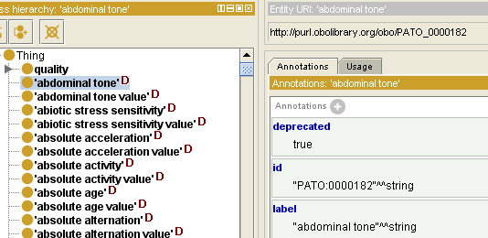
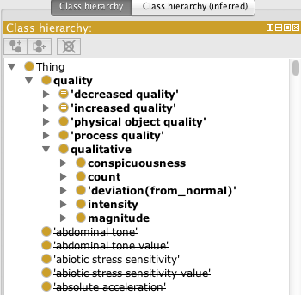
Deprecated Terms (1)
ObsoleteClass and ObsoleteProperty have been deprecated by OBO
Replaced by OWL DeprecatedClass/Property
  No parent class/property for all deprecated terms
  Using ‘deprecated’ annotation
Protégé 4.1, 4.2 alpha
Coming Protégé 4.2

Slide 19
Deprecated Terms (2)
Deprecated terms are indicated as
<owl:deprecated rdf:datatype="http://www.w3.org/2001/XMLSchema#boolean">true</owl:deprecated>
Set owl:deprecated with value"true"^^xsd:boolean
Deprecated terms are listed as the subclasses of OWL:thing
  Have contacted Protégé developers for rendering them nicely.
  (https://mailman.stanford.edu/pipermail/p4-feedback/2011-June/003966.html )

Slide 20
Other Tech Issues

Slide 21
Axioms of classes
Subclasses of Specimen
  Cell specimen, nasal swab specimen
    'has role' some 'specimen role‘
    material entity
  whole organism preparation
    material entity and 'has role' some 'specimen role‘
    material entity
  Processed specimen
    'processed material‘ and specimen
Nothing wrong, is it better to define them consistently?

Slide 22
Reagent Ontology
Reagent Ontology
  Would like to stand alone (an extension ontology of OBI?)
  OBI can import the Reagent ontology if we want
Question
  Add all the related terms in OBI (Like IEDB, FGED)
  Created OBI core, build extensions, like IDOMAL extend IDO, in more specific domains
Notes:
Matt and Carlo: As for the Reo Ontolgoy I'm in favor to have it as a stand alone module.

